Slide 1
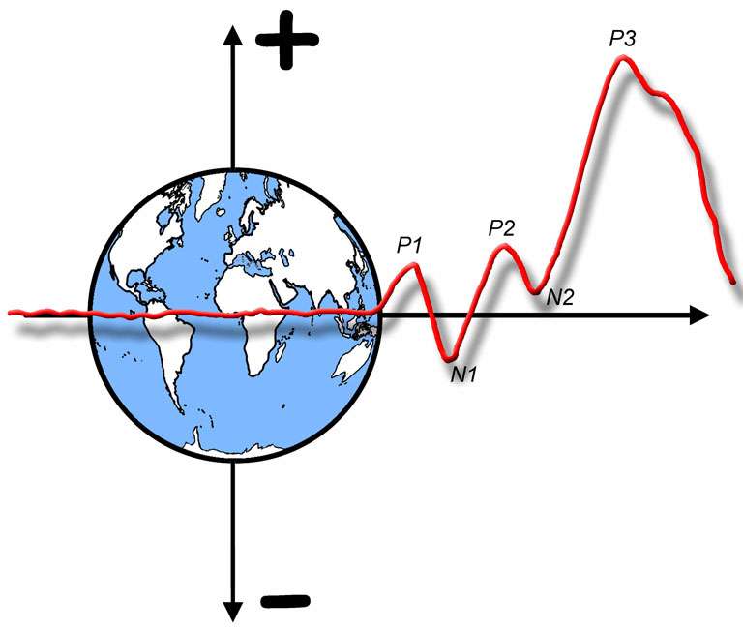

The ERP Boot Camp
ERP Localization

Slide 2
Why Are We Here?
Caveat: I tend to be very skeptical about ERP localization
My general advice: ERP localization is for a small set of experts
So, why are we here?
Localization can be valuable under some conditions
You may want to do it someday
Especially if you gain access to MEG
It can work well if you know you have 1-2 dipoles
A reviewer may insist you do it
You need to be able to read and critically evaluate localization papers
Notes:
© S. J. Luck. All Rights Reserved. May be used for nonprofit educational purposes if this copyright notice is included. Permission must be obtained from the copyright holder(s) for any other use.

Slide 3
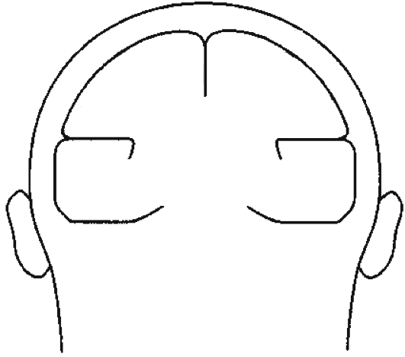
From Source to Scalp
C1
C2
C3
w_{1,1}
E1
w_{2,1}
w_{3,1}
w_{1,2}
w_{2,2}
E2
w_{3,2}
w_{1,3}
w_{2,3}
E3
w_{3,3}
E1
E2
Voltage at an electrode at time t is a weighted sum of all components that are active at time t
Forward Problem: Given sources, what are scalp waveforms?
Inverse Problem: Given scalp waveforms, what are sources?
C3
E3
C1
C2
Notes:
© S. J. Luck. All Rights Reserved. May be used for nonprofit educational purposes if this copyright notice is included. Permission must be obtained from the copyright holder(s) for any other use.

Slide 4
The Forward Problem
Trivial to solve if we assume head is a sphere
Still tractable with realistic model of the shape and conductivity of the head
Finite element model- Divide volume of head into large number of small homogeneous cubes
Boundary element model- Assume homogeneity within large regions and create detailed model of boundaries between regions
Notes:
© S. J. Luck. All Rights Reserved. May be used for nonprofit educational purposes if this copyright notice is included. Permission must be obtained from the copyright holder(s) for any other use.

Slide 5
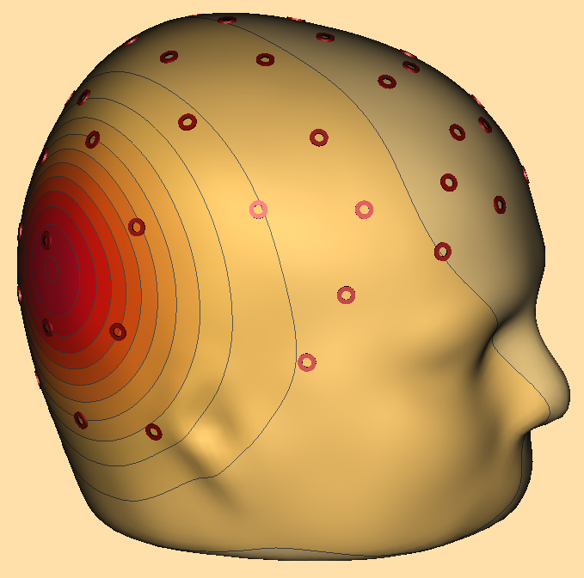
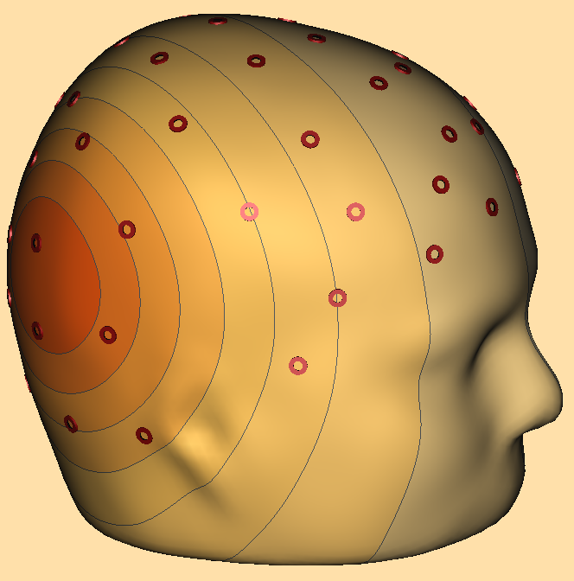
Scalp Distribution Examples
Single superficial dipole creates relatively focused scalp distribution
Distribution changes quite a bit as dipole is rotated or shifted
Easy to localize with reasonable precision
Deeper dipole creates broader scalp distribution
Changes in dipole location have smaller impact on scalp distribution
Harder to localize with precision (especially if data are noisy)
Hard to distinguish from broadly distributed superficial activity
Example: ERN and ACC
Courtesy of Jesse Bengson
Notes:
© S. J. Luck. All Rights Reserved. May be used for nonprofit educational purposes if this copyright notice is included. Permission must be obtained from the copyright holder(s) for any other use.

Slide 6
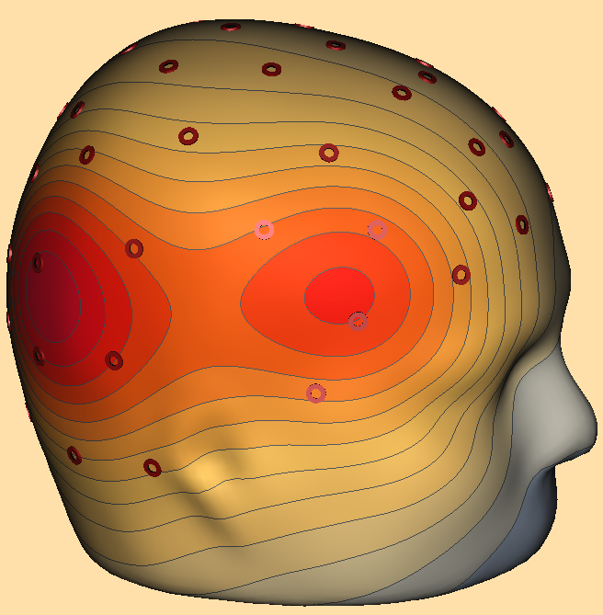
Scalp Distribution Examples
Can still localize reasonably well with 2 dipoles, as long as they are reasonably far apart and superficial
Courtesy of Jesse Bengson
Notes:
© S. J. Luck. All Rights Reserved. May be used for nonprofit educational purposes if this copyright notice is included. Permission must be obtained from the copyright holder(s) for any other use.

Slide 7
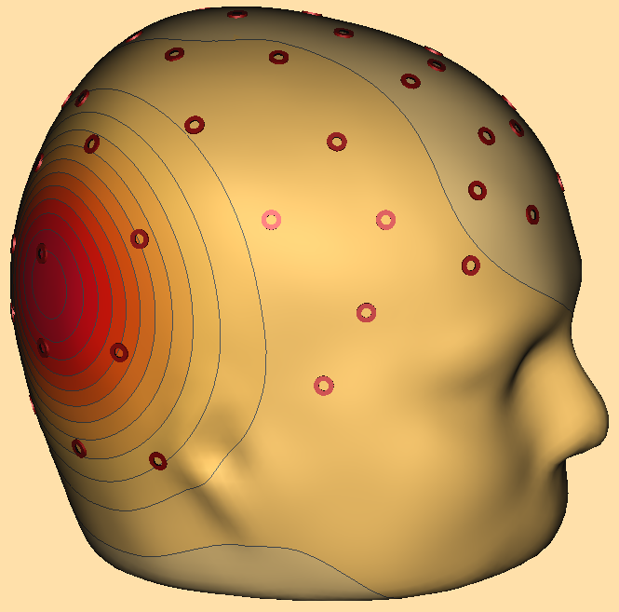
Scalp Distribution Examples
Some pairs of dipoles make localization difficult
Example: 2 colinear dipoles
As the number of dipoles increases, the likelihood of a difficult-to-localize situation becomes greater
Bottom line: ERP spatial resolution is not really “poor” — it is complex and hard to define
Courtesy of Jesse Bengson
Notes:
© S. J. Luck. All Rights Reserved. May be used for nonprofit educational purposes if this copyright notice is included. Permission must be obtained from the copyright holder(s) for any other use.

Slide 8
The Inverse Problem
Ill-posed problem- No unique solution
Infinite number of solutions for any observed voltage distribution
Given noise, the correct solution may differ substantially from the solution with the best fit
Notes:
© S. J. Luck. All Rights Reserved. May be used for nonprofit educational purposes if this copyright notice is included. Permission must be obtained from the copyright holder(s) for any other use.

Slide 9
Equivalent Current Dipole Approach
Example: Brain Electrical Source Analysis (BESA)
Assume a small number of equivalent dipoles (< 10)
Locations and orientations remain fixed over time and conditions, but magnitudes vary
Compare forward solution with observed scalp distributions over a range of time points
Find locations and orientations that, together, provide the best fit over the time range (iterative error minimization)
Each dipole has 5 parameters plus magnitude
Location (3 parameters)
Orientation (2 parameters)
Magnitude (1 parameter — treated differently, because it is estimated separately at each time point)
That’s a lot of free parameters!
Notes:
© S. J. Luck. All Rights Reserved. May be used for nonprofit educational purposes if this copyright notice is included. Permission must be obtained from the copyright holder(s) for any other use.

Slide 10
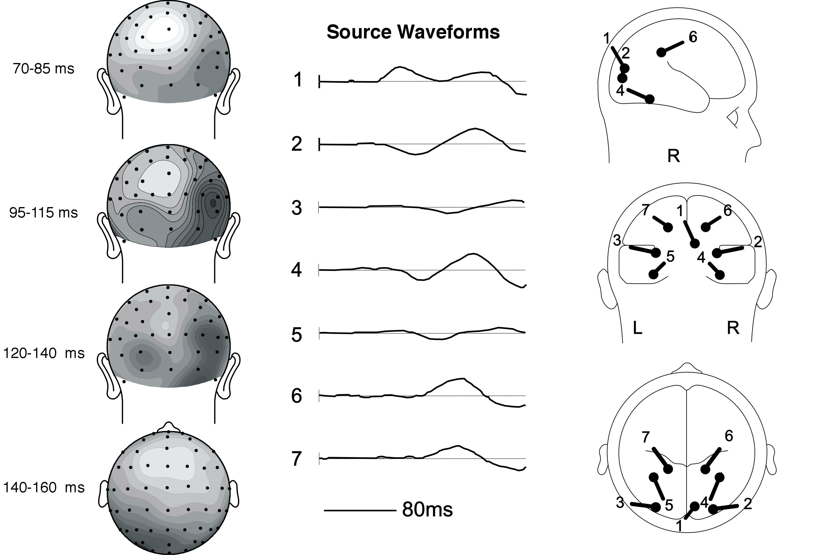
Di Russo et al. (2002)
Notes:
Adapted from Figure 5 and Figure 7 from Di Russo, F., Marínez, A., Sereno, M., Pitzalis, S., Hillyard, S. A. (2002) Cortical Sources of the Early Components of the Visual Evoked Potential. Human Brain Mapping 15,2, 95-111. Reprinted with the permission of Wiley-Liss, Inc., a subsidiary of John Wiley & Sons, Inc. This material may be used for nonprofit research and education purposes only, and it may not be reprinted or distributed in any form including print and electronic forms.

Slide 11
BESA
Notes:
© S. J. Luck. All Rights Reserved. May be used for nonprofit educational purposes if this copyright notice is included. Permission must be obtained from the copyright holder(s) for any other use.

Slide 12
Main Shortcomings of BESA
Operator Dependence
Solution depends on number of dipoles, starting locations, etc.
Easily biased by expectations
Difficult to assess accuracy of a solution
5 free parameters per dipole; 6-dipole solution would have 30 free parameters
When one parameter is incorrect, other variables can change slightly to maintain low residual variance
In the presence of noise or errors in forward solution, a substantially wrong solution may have lower residual variance than the correct solution
Notes:
© S. J. Luck. All Rights Reserved. May be used for nonprofit educational purposes if this copyright notice is included. Permission must be obtained from the copyright holder(s) for any other use.

Slide 13
BESA- Conclusions
Conclusion 1: When only 1 dipole is present, it can be localized reasonably well
But hard to quantify the margin of error
2-3 dipoles can be localized if they are superficial and far apart
Conclusion 2: With more complex situations, missing dipoles, spurious dipoles, and large errors are likely
So don’t put much faith in BESA results unless you can be sure that only a few distinct dipoles are present
There is a clear trend away from BESA among sophisticated ERP researchers
Note: Scherg himself primarily uses BESA in relatively simple sensory experiments with a small number of dipoles and a lot of extra constraints
Notes:
© S. J. Luck. All Rights Reserved. May be used for nonprofit educational purposes if this copyright notice is included. Permission must be obtained from the copyright holder(s) for any other use.

Slide 14
Distributed Source Approaches
C1
C2
C3
w_{1,1}
E1
w_{2,1}
w_{3,1}
w_{1,2}
w_{2,2}
E2
w_{3,2}
w_{1,3}
w_{2,3}
E3
w_{3,3}
E1
E2
Voltage at an electrode at time t is a weighted sum of all components that are active at time t
C3
E3
C1
C2
Notes:
© S. J. Luck. All Rights Reserved. May be used for nonprofit educational purposes if this copyright notice is included. Permission must be obtained from the copyright holder(s) for any other use.

Slide 15
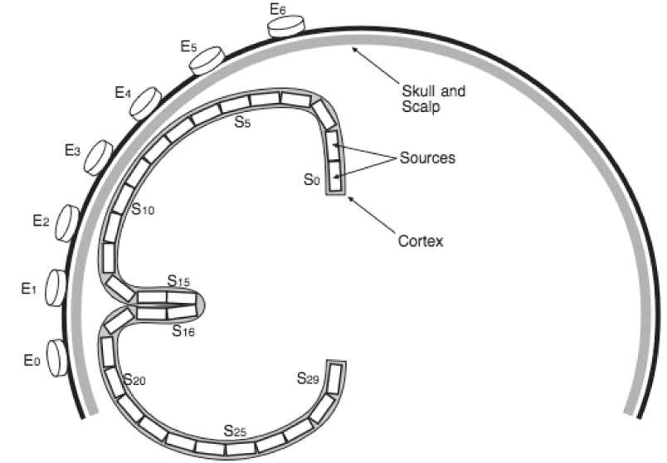
Distributed Source Approaches
Voltage at a given electrode =
Sum of voltage at each source x Weight for each source-electrode pair
e₅ = w_{0,5}s₀ + w_{1,5}s₁ + w_{2,5}s₂ + …
e_{N} = ∑w_{N,M}s_{M}
Notes:
Figure 7.3 from Luck, Steven J. (2005). An introduction to the Event-Related Potential Technique. Cambridge, MA: MIT Press.© MIT Press. This material may be used for nonprofit research and education purposes only, and it may not be reprinted or distributed in any form including print and electronic forms.
Other content: © S. J. Luck. All Rights Reserved. May be used for nonprofit educational purposes if this copyright notice is included. Permission must be obtained from the copyright holder(s) for any other use.

Slide 16
Distributed Source Approaches
e_{N} = ∑w_{N,M}s_{M}
Each weight (w) depends on orientation of source with respect to electrode and conductivities of brain, skull, etc.
E = WS (in vector notation)
S = (1/W)E (multiply both sides by 1/W)
1/W is the matrix inversion of W
Because N << M, W cannot be inverted
Need to choose a pseudo-inverse of W
Even if N > M, we would need to deal with noise
Notes:
© S. J. Luck. All Rights Reserved. May be used for nonprofit educational purposes if this copyright notice is included. Permission must be obtained from the copyright holder(s) for any other use.

Slide 17
Distributed Source Approaches
Problem: S₁₅ and S₁₆ cancel out
They can both be huge with very little impact on scalp
Solution: Choose solution with smallest overall energy (minimum norm)
Notes:
Figure 7.3 from Luck, Steven J. (2005). An introduction to the Event-Related Potential Technique. Cambridge, MA: MIT Press.© MIT Press. This material may be used for nonprofit research and education purposes only, and it may not be reprinted or distributed in any form including print and electronic forms.
Other content: © S. J. Luck. All Rights Reserved. May be used for nonprofit educational purposes if this copyright notice is included. Permission must be obtained from the copyright holder(s) for any other use.

Slide 18
Distributed Source Approaches
Minimum norm provides a unique solution
But it’s not guaranteed to be the correct solution
Minimum norm is biased against deep sources
Deep sources must be strong to have much impact at the scalp, and minimum norm is weighted against strong sources
Depth-weighted minimum norm solution can be used (better, but still not necessarily the correct solution)
LORETA- Low-Resolution Electromagnetic Tomography (Pascual-Marqui)
Chooses the solution that is maximally smooth
May work well for center of mass, but is by definition bad when sharp discontinuities exist
Notes:
© S. J. Luck. All Rights Reserved. May be used for nonprofit educational purposes if this copyright notice is included. Permission must be obtained from the copyright holder(s) for any other use.

Slide 19
Added Value of MEG
Notes:
Figure 7.3 from Luck, Steven J. (2005). An introduction to the Event-Related Potential Technique. Cambridge, MA: MIT Press.© MIT Press. This material may be used for nonprofit research and education purposes only, and it may not be reprinted or distributed in any form including print and electronic forms.
Other content: © S. J. Luck. All Rights Reserved. May be used for nonprofit educational purposes if this copyright notice is included. Permission must be obtained from the copyright holder(s) for any other use.

Slide 20
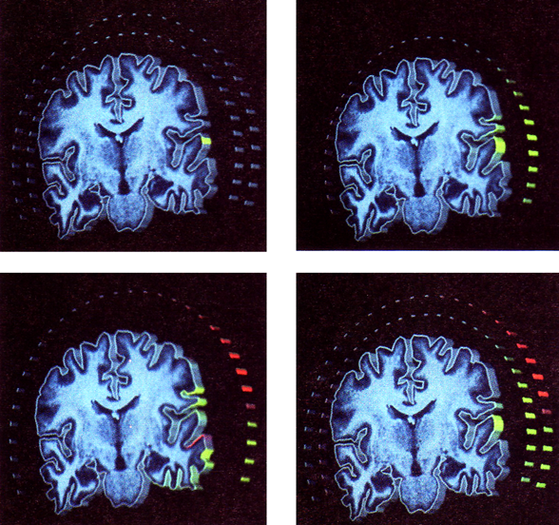
Added Value of MEG
Actual
Generator
ERP-Only Solution
ERMF-Only Solution
ERP+ERMF Solution
Why is ERMF-only solution so bad?
Dale & Sereno (1993)
Notes:
Figure 3 from Dale, A.M. and M.I. Sereno (1993) Improved localization of cortical activity by combining EEG and MEG with MRI cortical surface reconstruction: A linear approach. Journal of Cognitive Neuroscience, 5, 162-176. Reprinted with permission from the Massachusetts Institute of technology. This material may be used for nonprofit research and education purposes only, and it may not be reprinted or distributed in any form including print and electronic forms.

Slide 21
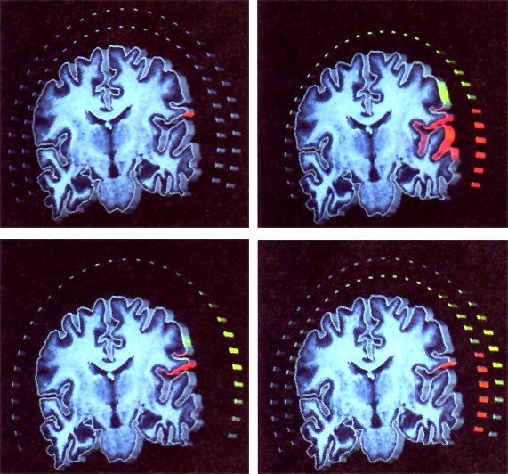
Added Value of MEG
Actual
Generator
ERP-Only Solution
ERMF-Only Solution
ERP+ERMF Solution
Dale & Sereno (1993)
Notes:
Figure 4 from Dale, A.M. and M.I. Sereno (1993) Improved localization of cortical activity by combining EEG and MEG with MRI cortical surface reconstruction: A linear approach. Journal of Cognitive Neuroscience, 5, 162-176. Reprinted with permission from the Massachusetts Institute of technology. This material may be used for nonprofit research and education purposes only, and it may not be reprinted or distributed in any form including print and electronic forms.

Slide 22
Measures vs. Models
In PET and fMRI, one can measure the strength of a signal at a given location inside the head
The physics provides an analytical means of triangulating the location of a signal
With ERPs/ERMFs, one creates a model based on fit to the data
It’s like creating a hypothesis to explain a set of previous results, and then using the fact that it explains those results as evidence that the hypothesis is correct
Even though other models fit the data just as well
Usually, models are considered valid in cognitive science and cognitive neuroscience only if they lead to new predictions that are then verified
Can we consider a localization result evidence, or is it merely a hypothesis that awaits a test?
Notes:
© S. J. Luck. All Rights Reserved. May be used for nonprofit educational purposes if this copyright notice is included. Permission must be obtained from the copyright holder(s) for any other use.

Slide 23
Testing Hypotheses
John Platt: Strong Inference
Experiments lead to scientific progress when the results can distinguish between competing hypotheses
What are the competing hypotheses being tested with source localization approaches?
Usually no explicit H₁ and H₀
Implicit H₁: “Effect comes from brain area X”
Implicit H₀: “Effect comes from any other area or combination of areas”
In most data sets, H₁ less likely than H₀
But the probability of H₁ is almost never compared to the probability of H₀
Some experiments compare H₁: “Effect comes from brain area X” vs. H₂: “Effect comes from area Y”
Notes:
© S. J. Luck. All Rights Reserved. May be used for nonprofit educational purposes if this copyright notice is included. Permission must be obtained from the copyright holder(s) for any other use.

Slide 24


Testing Hypotheses: Example
Distant Viewpoint:
Small Scale
Close-Up Viewpoint:
Large Scale
Hypothesis: Large scale involves anterior visual areas;
Small scale involves both anterior and posterior visual areas
Notes:
Adapted from Figure 1 from Hopf, J.-M., Luck, S. J., Boelmans, K., Schoenfeld, M. A., Boehler, N., Rieger, J., & Heinze, H.-J. (2006). The neural site of attention matches the spatial scale of perception. Journal of Neuroscience, 26, 3532-3540.
Reprinted with permission from The Journal of Neuroscience. This material may be used for nonprofit research and education purposes only, and it may not be reprinted or distributed in any form including print and electronic forms.

Slide 25
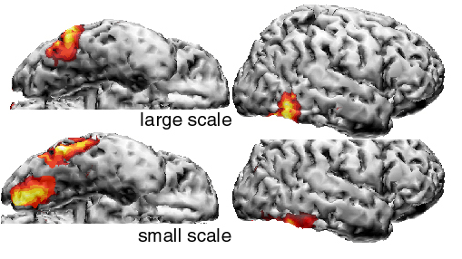
Source Density Estimates (Individual Subject)
Hopf et al.. (2006)
Notes:
Adapted from Figure 2 from Hopf, J.-M., Luck, S. J., Boelmans, K., Schoenfeld, M. A., Boehler, N., Rieger, J., & Heinze, H.-J. (2006). The neural site of attention matches the spatial scale of perception. Journal of Neuroscience, 26, 3532-3540. Reprinted with permission from The Journal of Neuroscience. This material may be used for nonprofit research and education purposes only, and it may not be reprinted or distributed in any form including print and electronic forms.

Slide 26
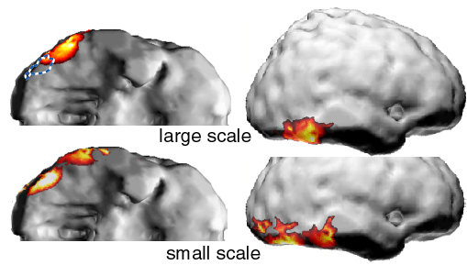
Source Density Estimates (Grand Average, N=10)
Notes:
Adapted from Figure 2 from Hopf, J.-M., Luck, S. J., Boelmans, K., Schoenfeld, M. A., Boehler, N., Rieger, J., & Heinze, H.-J. (2006). The neural site of attention matches the spatial scale of perception. Journal of Neuroscience, 26, 3532-3540. Reprinted with permission from The Journal of Neuroscience. This material may be used for nonprofit research and education purposes only, and it may not be reprinted or distributed in any form including print and electronic forms.

Slide 27
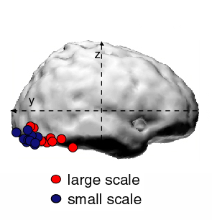
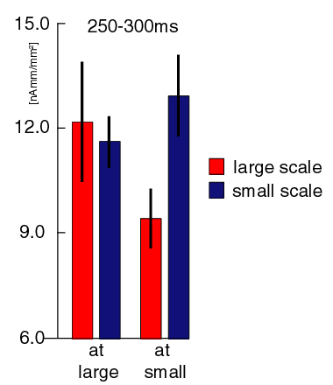
Statistical Analysis
Location of maximum current density in each subject
Magnitude of current density at maxima
Notes:
Adapted from Figure 2 from Hopf, J.-M., Luck, S. J., Boelmans, K., Schoenfeld, M. A., Boehler, N., Rieger, J., & Heinze, H.-J. (2006). The neural site of attention matches the spatial scale of perception. Journal of Neuroscience, 26, 3532-3540. Reprinted with permission from The Journal of Neuroscience. This material may be used for nonprofit research and education purposes only, and it may not be reprinted or distributed in any form including print and electronic forms.

Slide 28
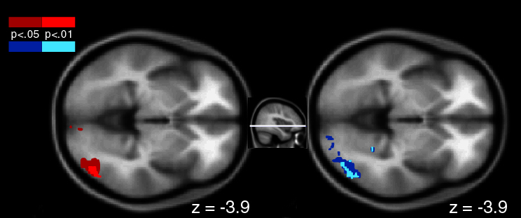
Validation with fMRI (N=6)
Large Scale
Small Scale
Lateral
Occipital
Complex
(Area TE)
Notes:
Adapted from Figure 5 from Hopf, J.-M., Luck, S. J., Boelmans, K., Schoenfeld, M. A., Boehler, N., Rieger, J., & Heinze, H.-J. (2006). The neural site of attention matches the spatial scale of perception. Journal of Neuroscience, 26, 3532-3540. Reprinted with permission from The Journal of Neuroscience. This material may be used for nonprofit research and education purposes only, and it may not be reprinted or distributed in any form including print and electronic forms.

Slide 29
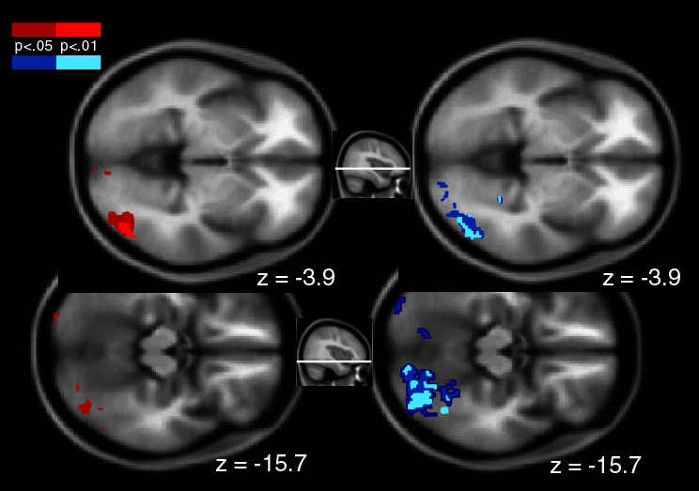
Validation with fMRI (N=6)
Large Scale
Small Scale
Lateral
Occipital
Complex
(Area TE)
(Area V4)
Notes:
Adapted from Figure 5 from Hopf, J.-M., Luck, S. J., Boelmans, K., Schoenfeld, M. A., Boehler, N., Rieger, J., & Heinze, H.-J. (2006). The neural site of attention matches the spatial scale of perception. Journal of Neuroscience, 26, 3532-3540. Reprinted with permission from The Journal of Neuroscience. This material may be used for nonprofit research and education purposes only, and it may not be reprinted or distributed in any form including print and electronic forms.

Slide 30
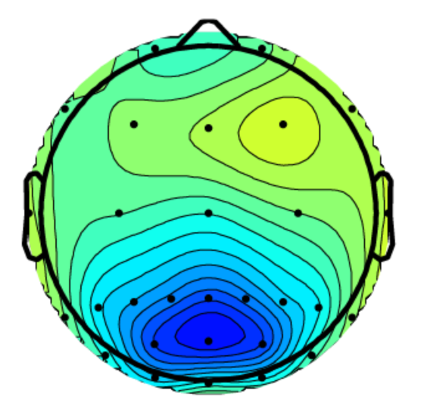
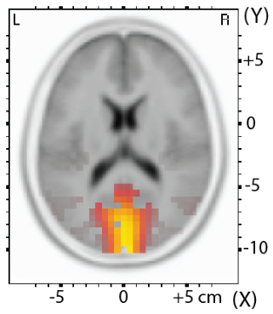
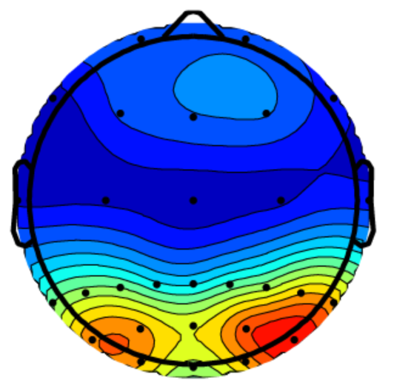
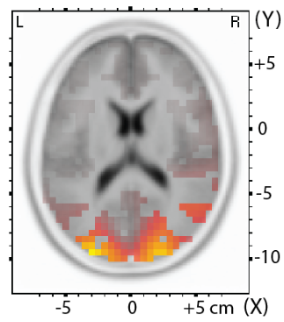
Example #2
You can also use source localization to ask whether the observed data are consistent with a generator in a specific, hypothesized region
Miller, C.E., Luck, S.J., & Shapiro, K.L. (2015). Electrophysiological measurement of the effect of inter-stimulus competition on early cortical stages of human vision. Neuroimage, 105, 229-237.
C1 Scalp Distribution
sLORETA Estimate
P1 Scalp Distribution
sLORETA Estimate
Notes:
© S. J. Luck. All Rights Reserved. May be used for nonprofit educational purposes if this copyright notice is included. Permission must be obtained from the copyright holder(s) for any other use.

Slide 31
New Directions
Spatial filter approaches (e.g., beamformers)
Goal: Estimate the activity over time in one specific region
Advantage: Tests a specific hypothesis
But: Still requires inverting an uninvertable matrix
Bayesian approaches
Approach: Combine all the uncertainties to assess probability of activity in each patch of cortex
But: The general problem with Bayesian approaches is that they can give very wrong results if the priors are wrong
Simultaneous EEG/fMRI
Approach 1: Use one signal to sort trials for other signal
Approach 2: Use trial-by-trial correlations to assess relationships between the two signals
Notes:
© S. J. Luck. All Rights Reserved. May be used for nonprofit educational purposes if this copyright notice is included. Permission must be obtained from the copyright holder(s) for any other use.

Slide 32
Recommendations
Source localization should be left to people who have the expertise, money, and equipment to do it well
If you attempt localization, take the general scientific approach of hypothesis testing
Feel free to play around with localization in the “context of discovery”
But remember that source localization techniques typically lead to a hypothesis about the generator location, not a conclusion
Don’t fool yourself into thinking that you have “measured” the activity arising from a specific area
Notes:
© S. J. Luck. All Rights Reserved. May be used for nonprofit educational purposes if this copyright notice is included. Permission must be obtained from the copyright holder(s) for any other use.

